Slide 1
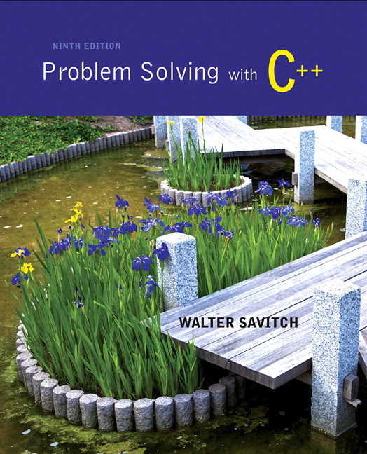
Problem Solving with C++ by Walter Savitch

Slide 2
Chapter 5
Functions for All Subtasks

Slide 3
Overview
5.1 void Functions
5.2 Call-By-Reference Parameters
5.3 Using Procedural Abstraction
5.4 Testing and Debugging
5.5 General Debugging Techniques

Slide 4
5.1
void Functions

Slide 5
void-Functions
In top-down design, a subtask might produce
No value (just input or output for example)
One value
More than one value
We have seen how to implement functions that return one value
A void-function implements a subtask that returns no value or more than one value

Slide 6
void-Function Definition
Two main differences between void-function definitions and the definitions of functions that return one value
Keyword void replaces the type of the value returned
void means that no value is returned by the function
The return statement does not include and expression
Example: void show_results(double f_degrees, double c_degrees) { using namespace std; cout << f_degrees << “ degrees Fahrenheit is euivalent to “ << endl << c_degrees << “ degrees Celsius.” << endl; return; }
Display 5.1

Slide 7
Using a void-Function
void-function calls are executable statements
They do not need to be part of another statement
They end with a semi-colon
Example: show_results(32.5, 0.3); NOT: cout << show_results(32.5, 0.3);

Slide 8
void-Function Calls
Mechanism is nearly the same as the function calls we have seen
Argument values are substituted for the formal parameters
It is fairly common to have no parameters in void-functions
In this case there will be no arguments in the function call
Statements in function body are executed
Optional return statement ends the function
Return statement does not include a value to return
Return statement is implicit if it is not included

Slide 9
Example: Converting Temperatures
The functions just developed can be used in a program to convert Fahrenheit temperatures to Celcius using the formula C = (5/9) (F – 32)
Do you see the integer division problem?
Display 5.2 (1)
Display 5.2 (2)

Slide 10
void-Functions Why Use a Return?
Is a return-statement ever needed in a void-function since no value is returned?
Yes!
What if a branch of an if-else statement requires that the function ends to avoid producing more output, or creating a mathematical error?
void-function in Display 5.3, avoids division by zero with a return statement
Display 5.3

Slide 11
The Main Function
The main function in a program is used like a void function…do you have to end the program with a return-statement?
Because the main function is defined to return a value of type int, the return is needed
C++ standard says the return 0 can be omitted, but many compilers still require it

Slide 12
Section 5.1 Conclusion
Can you
Describe the differences between void-functions and functions that return one value?
Tell what happens if you forget the return-statementin a void-function?
Distinguish between functions that are used as expressions and those used as statements?

Slide 13
5.2
Call-By-Reference Parameters

Slide 14
Call-by-Reference Parameters
Call-by-value is not adequate when we need a sub-task to obtain input values
Call-by-value means that the formal parameters receive the values of the arguments
To obtain input values, we need to change the variables that are arguments to the function
Recall that we have changed the values of formal parameters in a function body, but we have not changed the arguments found in the function call
Call-by-reference parameters allow us to change the variable used in the function call
Arguments for call-by-reference parameters must be variables, not numbers

Slide 15
Call-by-Reference Example
void get_input(double& f_variable) { using namespace std; cout << “ Convert a Fahrenheit temperature” << “ to Celsius.\n” << “ Enter a temperature in Fahrenheit: “; cin >> f_variable; }
‘&’ symbol (ampersand) identifies f_variable as a call-by-reference parameter
Used in both declaration and definition!
Display 5.4 (1)
Display 5.4 (2)

Slide 16
Call-By-Reference Details
Call-by-reference works almost as if the argument variable is substituted for the formal parameter, not the argument’s value
In reality, the memory location of the argument variable is given to the formal parameter
Whatever is done to a formal parameter in the function body, is actually done to the value at the memory location of the argument variable
Display 5.5 (1)
Display 5.5 (2)

Slide 17
Call Comparisons Call By Reference vs Value
Call-by-value
The function call: f(age); void f(int var_par);
Call-by-reference
The function call: f(age); void
f(int& ref_par);
Memory
Name | Location | Contents
age | 1001 | 34
initial | 1002 | A
hours | 1003 | 23.5
 | 1004

Slide 18
Example: swap_values
void swap(int& variable1, int& variable2) { int temp = variable1; variable1 = variable2; variable2 = temp; }
If called with swap(first_num, second_num);
first_num is substituted for variable1 in the parameter list
second_num is substituted for variable2 in the parameter list
temp is assigned the value of variable1 (first_num) since the next line will loose the value in first_num
variable1 (first_num) is assigned the value in variable2 (second_num)
variable2 (second_num) is assigned the original value of variable1 (first_num) which was stored in temp`

Slide 19
Mixed Parameter Lists
Call-by-value and call-by-reference parameters can be mixed in the same function
Example: void good_stuff(int& par1, int par2, double& par3);
par1 and par3 are call-by-reference formal parameters
Changes in par1 and par3 change the argument variable
par2 is a call-by-value formal parameter
Changes in par2 do not change the argument variable

Slide 20
Choosing Parameter Types
How do you decide whether a call-by-reference or call-by-value formal parameter is needed?
Does the function need to change the value of the variable used as an argument?
Yes? Use a call-by-reference formal parameter
No? Use a call-by-value formal parameter
Display 5.6

Slide 21
Inadvertent Local Variables
If a function is to change the value of a variable the corresponding formal parameter must be a call-by-reference parameter with an ampersand (&) attached
Forgetting the ampersand (&) creates a call-by-value parameter
The value of the variable will not be changed
The formal parameter is a local variable that has no effect outside the function
Hard error to find…it looks right!
Display 5.7

Slide 22
Section 5.2 Conclusion
Can you
Write a void-function definition for a function called zero_both that has two reference parameters, both of which are variables of type int, and sets the values of both variables to 0.
Write a function that returns a value and has a call-by-reference parameter?
Write a function with both call-by-value and call-by-reference parameters

Slide 23
5.3
Using Procedural Abstraction

Slide 24
Using Procedural Abstraction
Functions should be designed so they can be used as black boxes
To use a function, the declaration and comment should be sufficient
Programmer should not need to know the details of the function to use it

Slide 25
Functions Calling Functions
A function body may contain a call to another function
The called function declaration must still appear before it is called
Functions cannot be defined in the body of another function
Example: void order(int& n1, int& n2) { if (n1 > n2) swap_values(n1, n2); }
swap_values called if n1 and n2 are not in ascending order
After the call to order, n1 and n2 are in ascending order
Display 5.8 (1)
Display 5.8 (2)

Slide 26
Pre and Postconditions
Precondition
States what is assumed to be true when the function is called
Function should not be used unless the precondition holds
Postcondition
Describes the effect of the function call
Tells what will be true after the function is executed (when the precondition holds)
If the function returns a value, that value is described
Changes to call-by-reference parameters are described

Slide 27
swap_values revisited
Using preconditions and postconditions the declaration of swap_values becomes: void swap_values(int& n1, int& n2); //Precondition: variable1 and variable 2 have // been given values // Postcondition: The values of variable1 and // variable2 have been // interchanged

Slide 28
Function celsius
Preconditions and postconditions make the declaration for celsius: double celsius(double farenheit); //Precondition: fahrenheit is a temperature // expressed in degrees Fahrenheit //Postcondition: Returns the equivalent temperature // expressed in degrees Celsius

Slide 29
Why use preconditions and postconditions?
Preconditions and postconditions
should be the first step in designing a function
specify what a function should do
Always specify what a function should do before designing how the function will do it
Minimize design errors
Minimize time wasted writing code that doesn’t match the task at hand

Slide 30
Case Study Supermarket Pricing
Problem definition
Determine retail price of an item given suitable input
5% markup if item should sell in a week
10% markup if item expected to take more than a week
5% for up to 7 days, changes to 10% at 8 days
Input
The wholesale price and the estimate of days until item sells
Output
The retail price of the item

Slide 31
Supermarket Pricing: Problem Analysis
Three main subtasks
Input the data
Compute the retail price of the item
Output the results
Each task can be implemented with a function
Notice the use of call-by-value and call-by-reference parameters in the following function declarations

Slide 32
Supermarket Pricing: Function get_input
void get_input(double& cost, int& turnover); //Precondition: User is ready to enter values // correctly. //Postcondition: The value of cost has been set to // the wholesale cost of one item. // The value of turnover has been // set to the expected number of // days until the item is sold.

Slide 33
Supermarket Pricing: Function price
double price(double cost, int turnover); //Precondition: cost is the wholesale cost of one // item. turnover is the expected // number of days until the item is // sold. //Postcondition: returns the retail price of the item

Slide 34
Supermarket Pricing: Function give_output
void give_output(double cost, int turnover, double price); //Precondition: cost is the wholesale cost of one item; // turnover is the expected time until sale // of the item; price is the retail price of // the item. //Postcondition: The values of cost, turnover, and price // been written to the screen.

Slide 35
Supermarket Pricing: The main function
With the functions declared, we can write the main function: int main() { double wholesale_cost, retail_price; int shelf_time; get_input(wholesale_cost, shelf_time); retail_price = price(wholesale_cost, shelf_time); give_output(wholesale_cost, shelf_time, retail_price); return 0; }

Slide 36
Supermarket Pricing: Algorithm Design -- price
Implementations of get_input and give_output are straightforward, so we concentrate on the price function
pseudocode for the price function
If turnover <= 7 days then return (cost + 5% of cost); else return (cost + 10% of cost);

Slide 37
Supermarket Pricing: Constants for The price Function
The numeric values in the pseudocode will be represented by constants
Const double LOW_MARKUP = 0.05; // 5%
Const double HIGH_MARKUP = 0.10; // 10%
Const int THRESHOLD = 7; // At 8 days use //HIGH_MARKUP

Slide 38
Supermarket Pricing: Coding The price Function
The body of the price function
{ if (turnover <= THRESHOLD) return ( cost + (LOW_MARKUP * cost) ) ; else return ( cost + ( HIGH_MARKUP * cost) ) ; }
See the complete program in
Display 5.9 (1)
Display 5.9 (2)
Display 5.9 (3)

Slide 39
Supermarket Pricing : Program Testing
Testing strategies
Use data that tests both the high and low markup cases
Test boundary conditions, where the program is expected to change behavior or make a choice
In function price, 7 days is a boundary condition
Test for exactly 7 days as well as one day more and one day less

Slide 40
Section 5.3 Conclusion
Can you
Define a function in the body of another function?
Call one function from the body of another function?
Give preconditions and postconditions for the predefined function sqrt?

Slide 41
5.4
Testing and Debugging

Slide 42
Testing and Debugging Functions
Each function should be tested as a separate unit
Testing individual functions facilitates finding mistakes
Driver programs allow testing of individual functions
Once a function is tested, it can be used in the driver program to test other functions
Function get_input is tested in the driver program of and
Display 5.10 (1)
Display 5.10 (2)

Slide 43
Stubs
When a function being tested calls other functions that are not yet tested, use a stub
A stub is a simplified version of a function
Stubs are usually provide values for testing rather than perform the intended calculation
Stubs should be so simple that you have confidence they will perform correctly
Function price is used as a stub to test the rest of the supermarket pricing program in and
Display 5.11 (1)
Display 5.11 (2)

Slide 44
Rule for Testing Functions
Fundamental Rule for Testing Functions
Test every function in a program in which every other function in that program has already been fully tested and debugged.

Slide 45
Section 5.4 Conclusion
Can you
Describe the fundamental rule for testing functions?
Describe a driver program?
Write a driver program to test a function?
Describe and use a stub?
Write a stub?

Slide 46
5.5
General Debugging Techniques

Slide 47
General Debugging Techniques
Stubs, drivers, test cases as described in the previous section
Keep an open mind
Don’t assume the bug is in a particular location
Don’t randomly change code without understanding what you are doing until the program works
This strategy may work for the first few small programs you write but is doomed to failure for any programs of moderate complexity
Show the program to someone else

Slide 48
General Debugging Techniques
Check for common errors, e.g.
Local vs. Reference Parameter
= instead of ==
Localize the error
This temperature conversion program has a bug
Narrow down bug using cout statements
Display 5.12
Display 5.13

Slide 49
General Debugging Techniques
Use a debugger
Tool typically integrated with a development environment that allows you to stop and step through a program line-by-line while inspecting variables
The assert macro
Can be used to test pre or post conditions
#include <cassert>
assert(boolean expression)
If the boolean is false then the program will abort

Slide 50
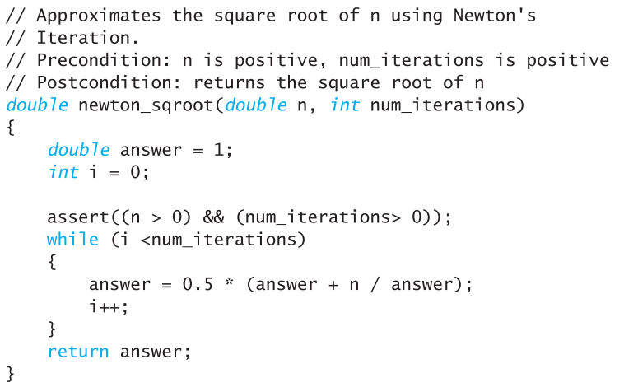
Assert Example
Denominator should not be zero in Newton’s Method

Slide 51
Section 5.5 Conclusion
Can you
Recognize common errors?
Use the assert macro?
Debug a program using cout statements to localize the error?
Debug a program using a debugger?

Slide 52
Chapter 5 -- End

Slide 53
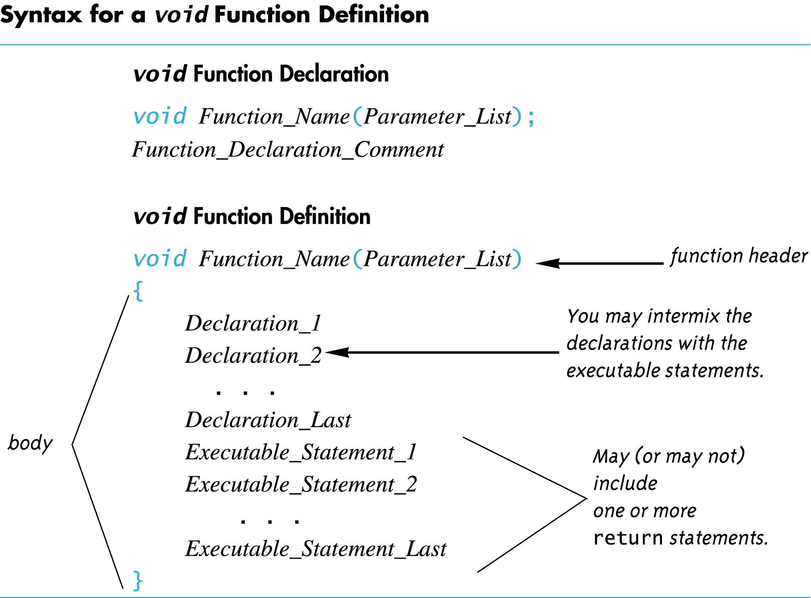
Display 5.1
Back
Next

Slide 54
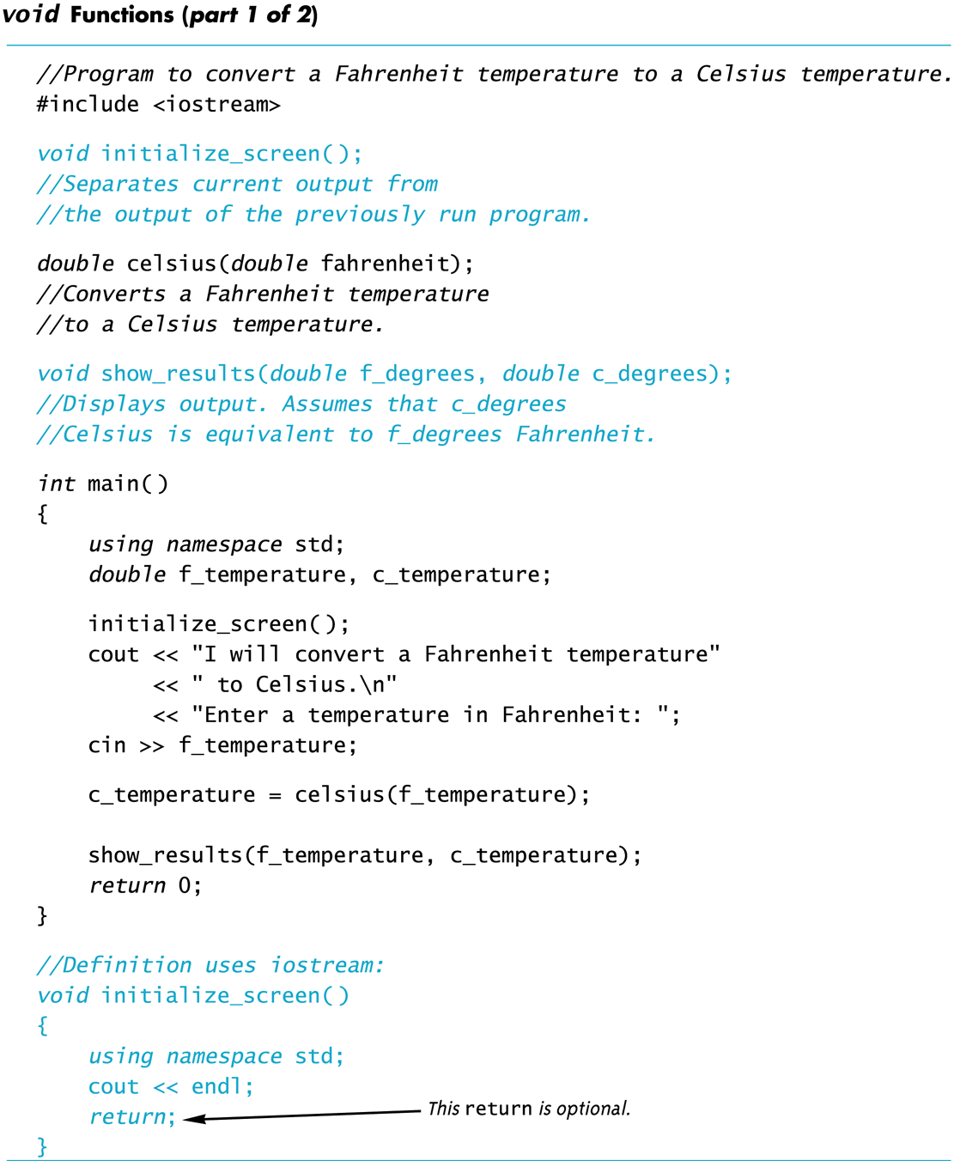
Display 5.2 (1/2)
Back
Next

Slide 55
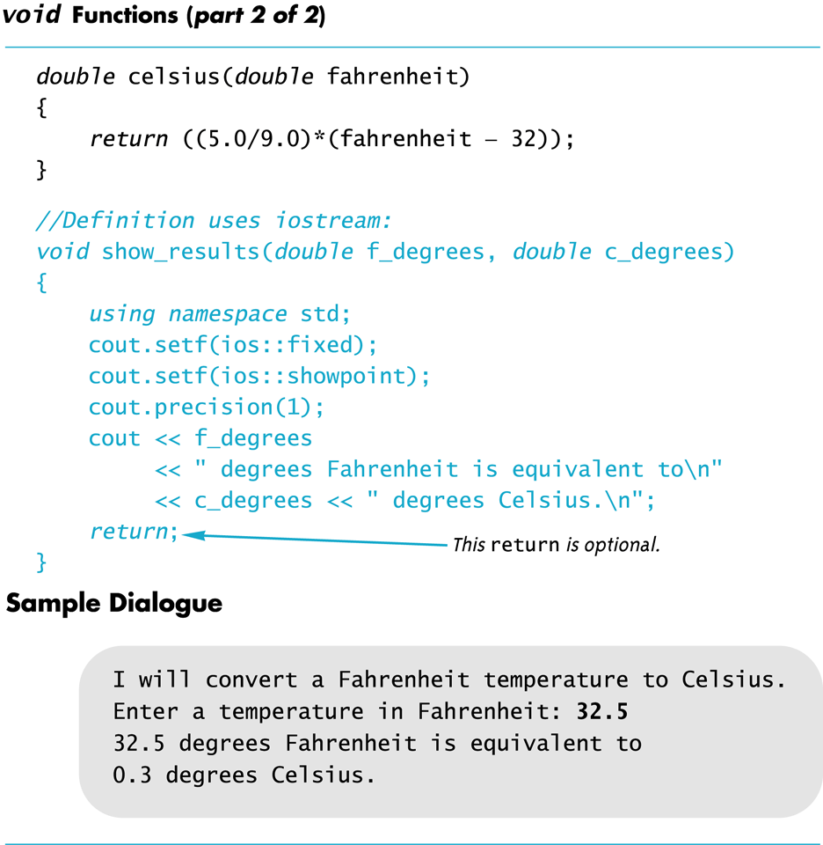
Display 5.2 (2/2)
Back
Next

Slide 56
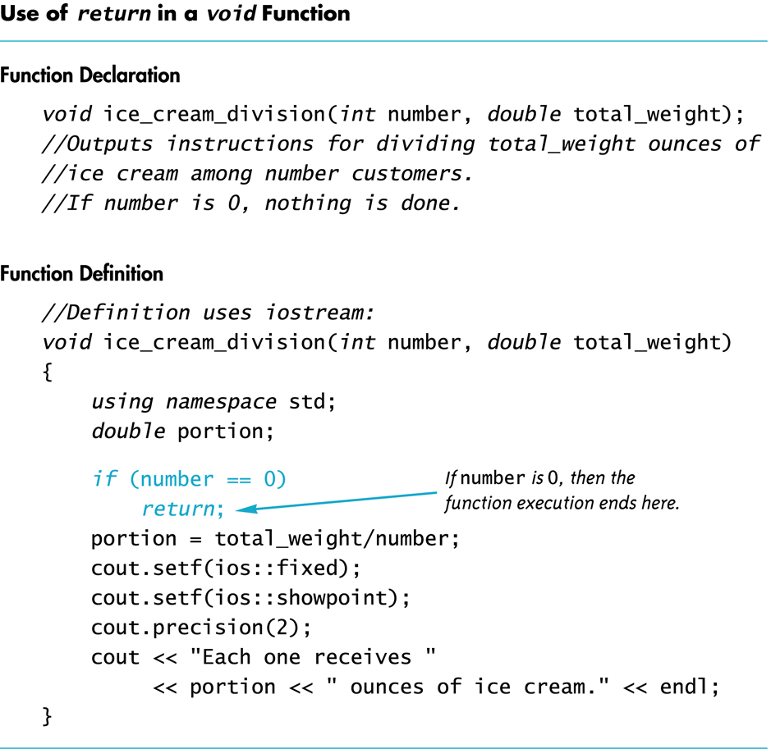
Display 5.3
Back
Next

Slide 57
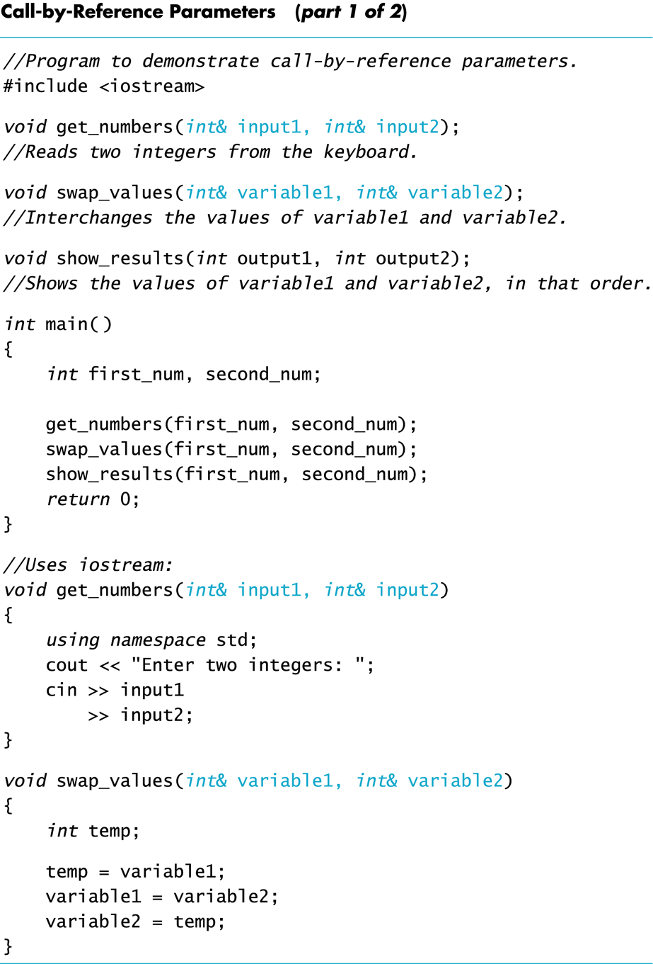
Display 5.4 (1/2)
Back
Next

Slide 58
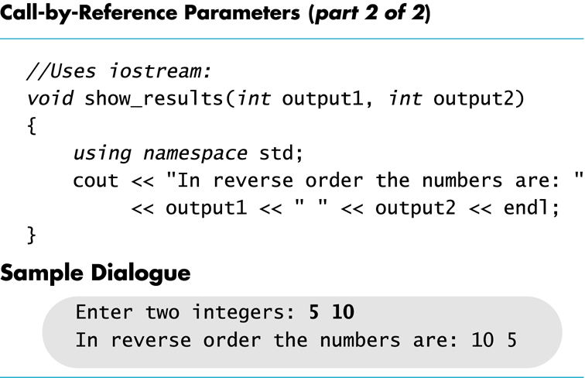
Display 5.4 (2/2)
Back
Next

Slide 59
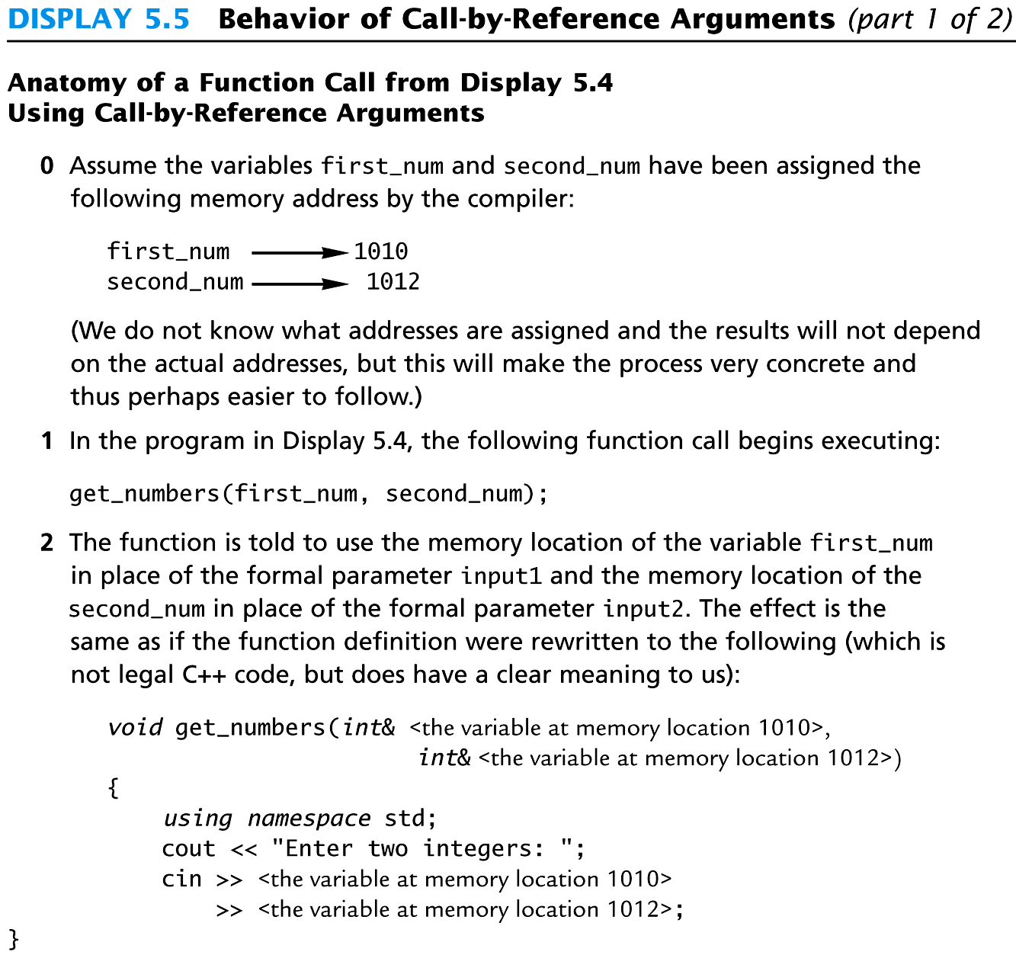
Display 5.5 (1/2)
Back
Next

Slide 60
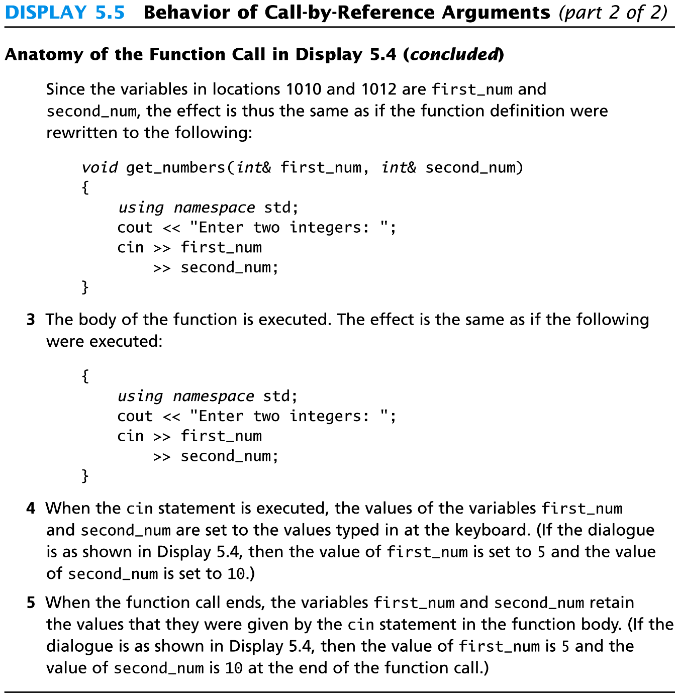
Display 5.5 (2/2)
Back
Next

Slide 61
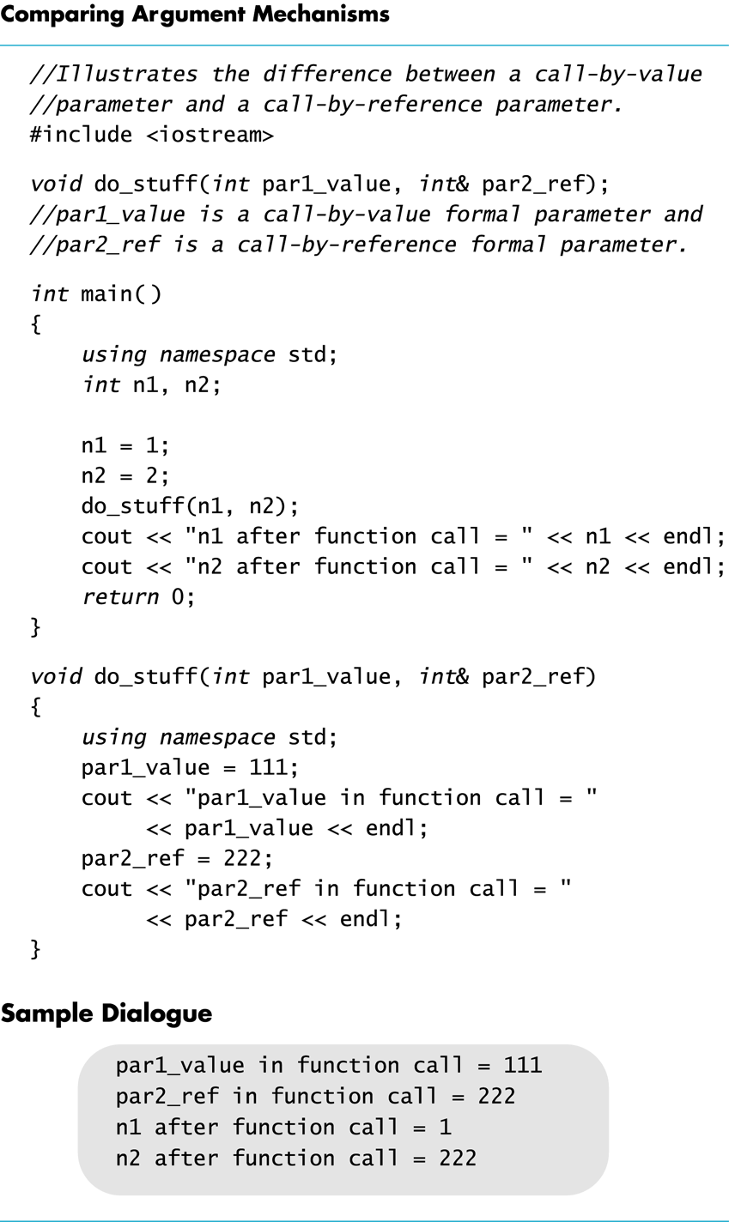
Display 5.6
Back
Next

Slide 62
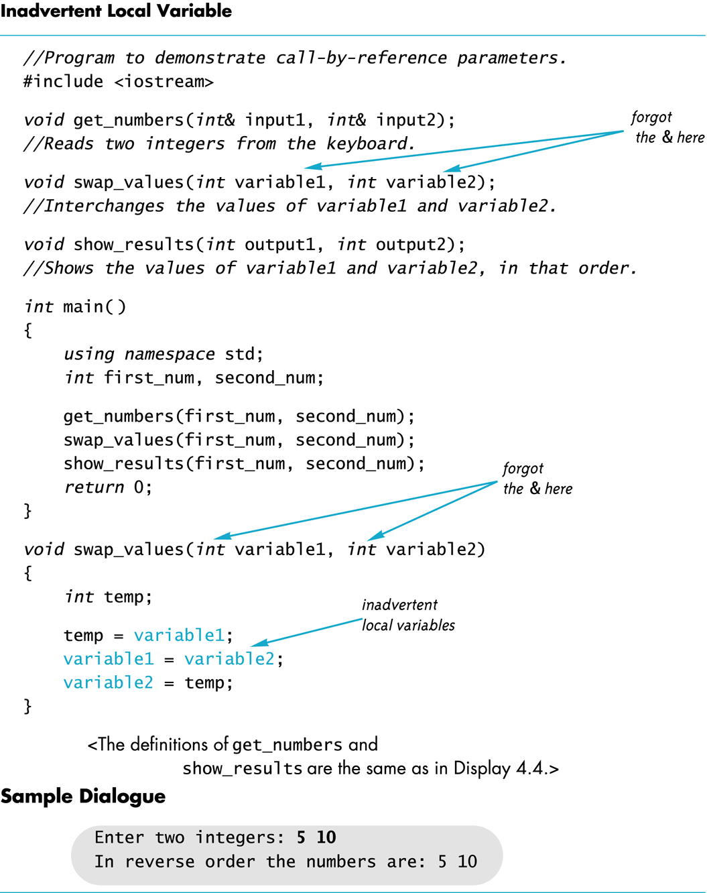
Display 5.7
Back
Next

Slide 63
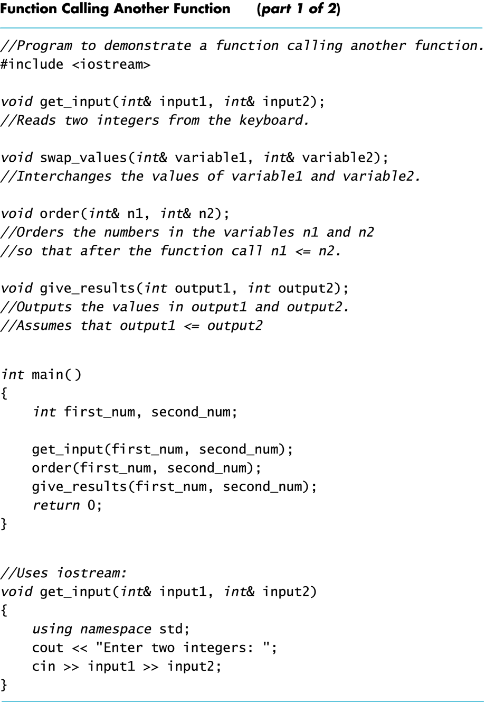
Display 5.8 (1/2)
Back
Next

Slide 64
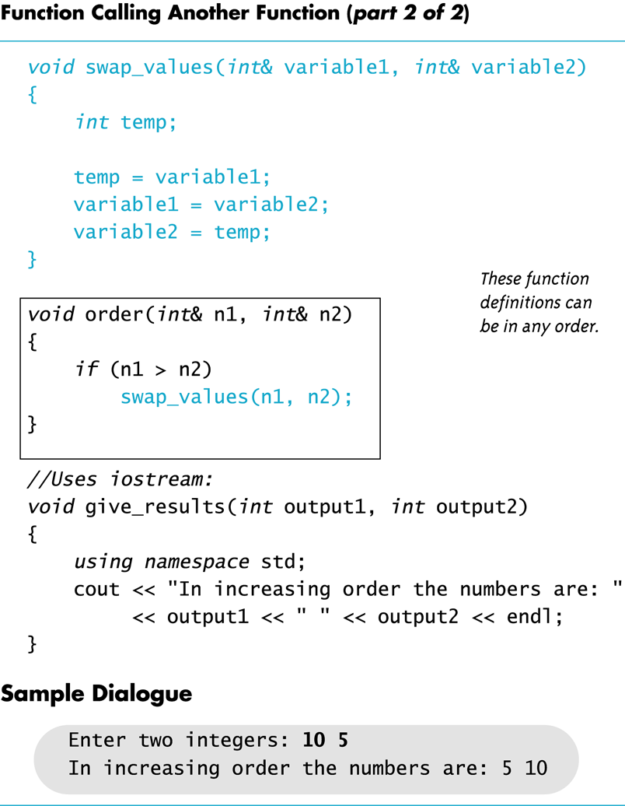
Display 5.8 (2/2)
Back
Next

Slide 65
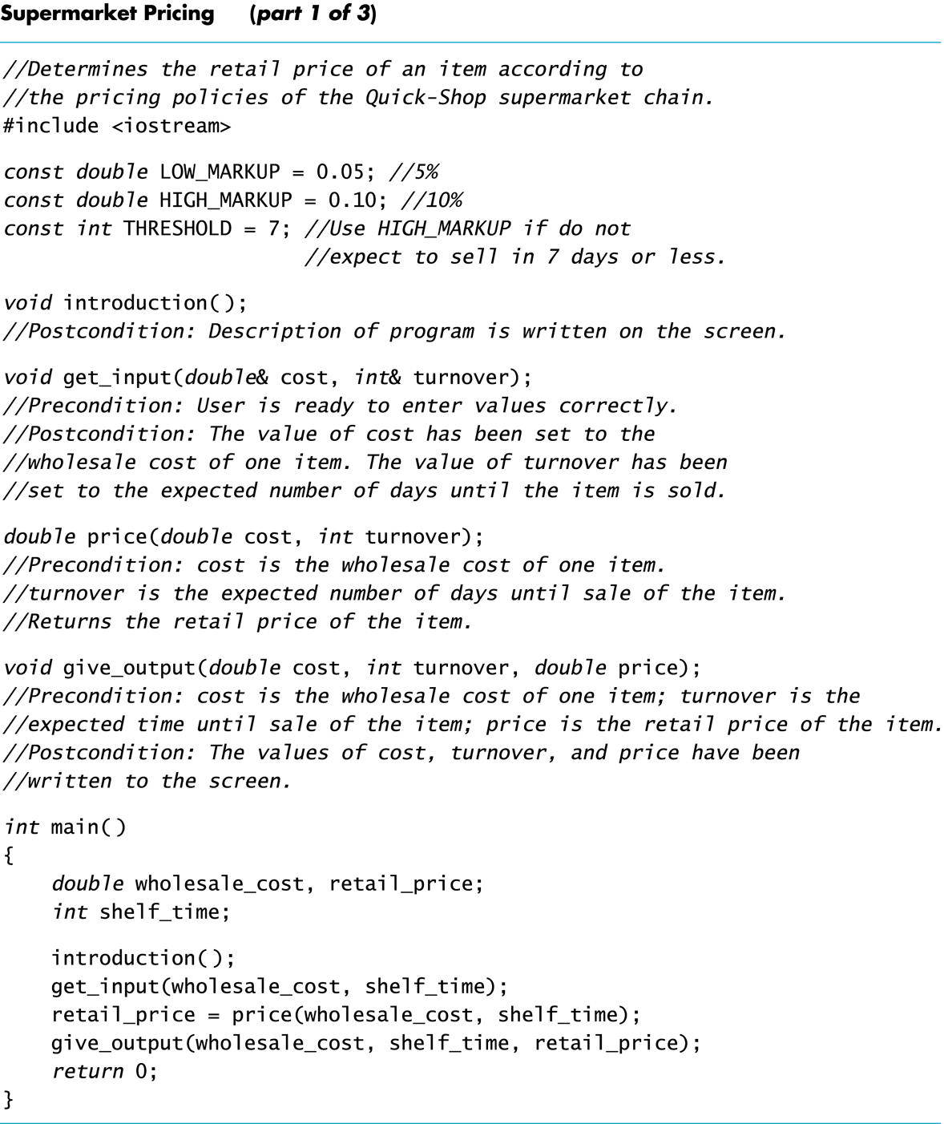
Display 5.9 (1/3)
Back
Next

Slide 66
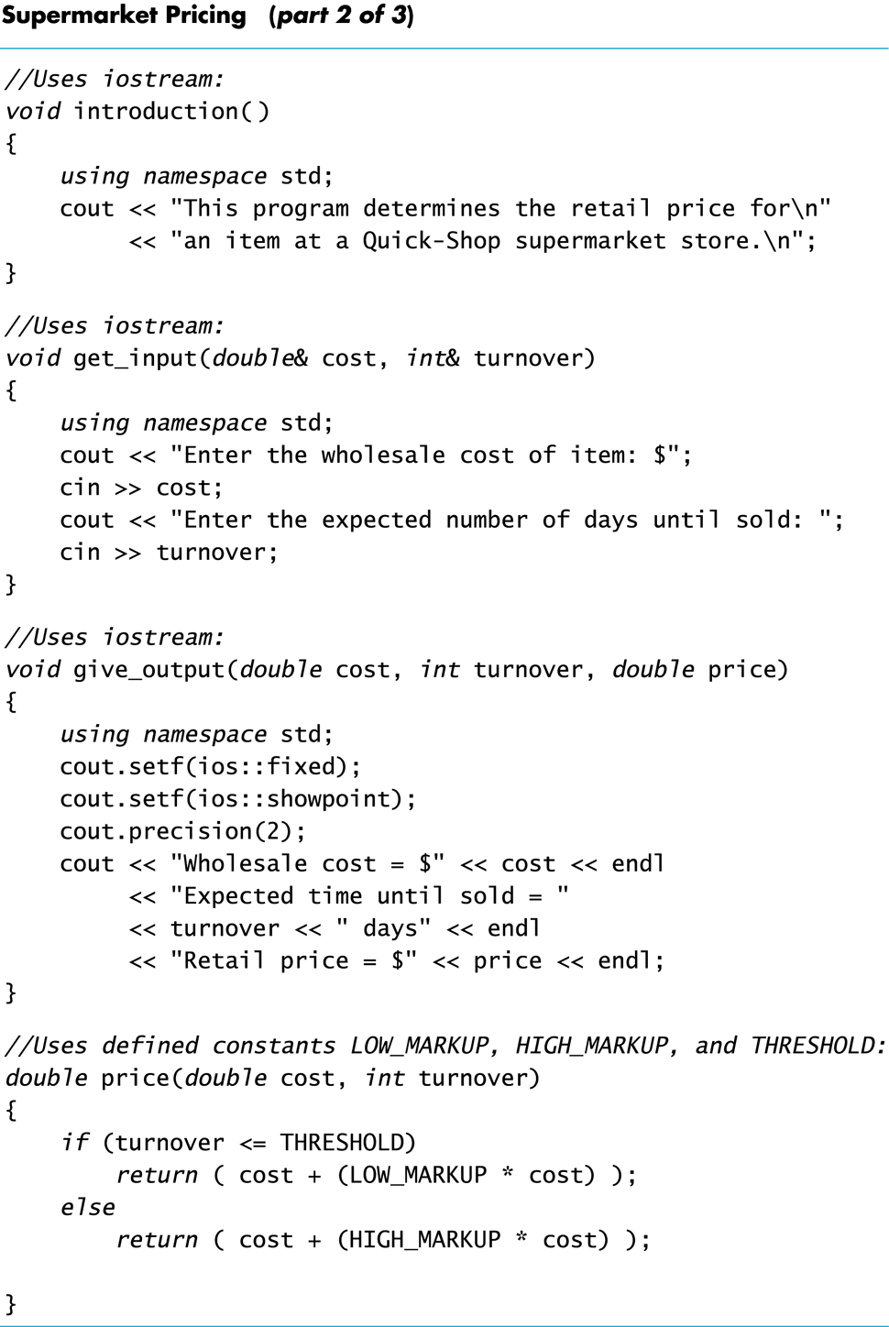
Display 5.9 (2/3)
Back
Next

Slide 67
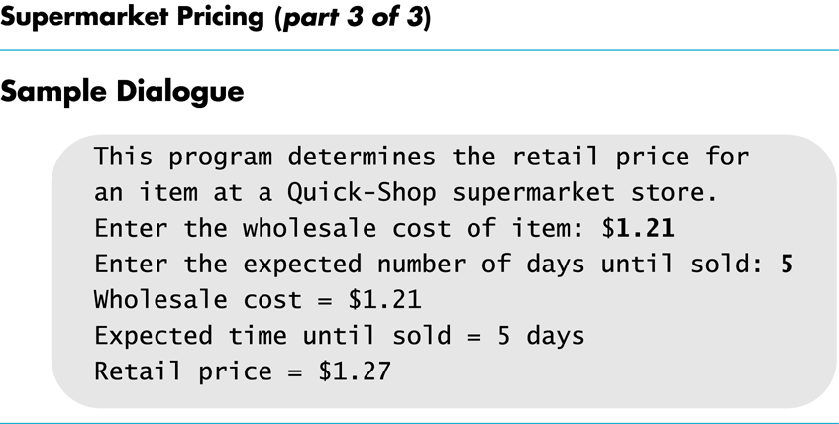
Display 5.9 (3/3)
Back
Next

Slide 68
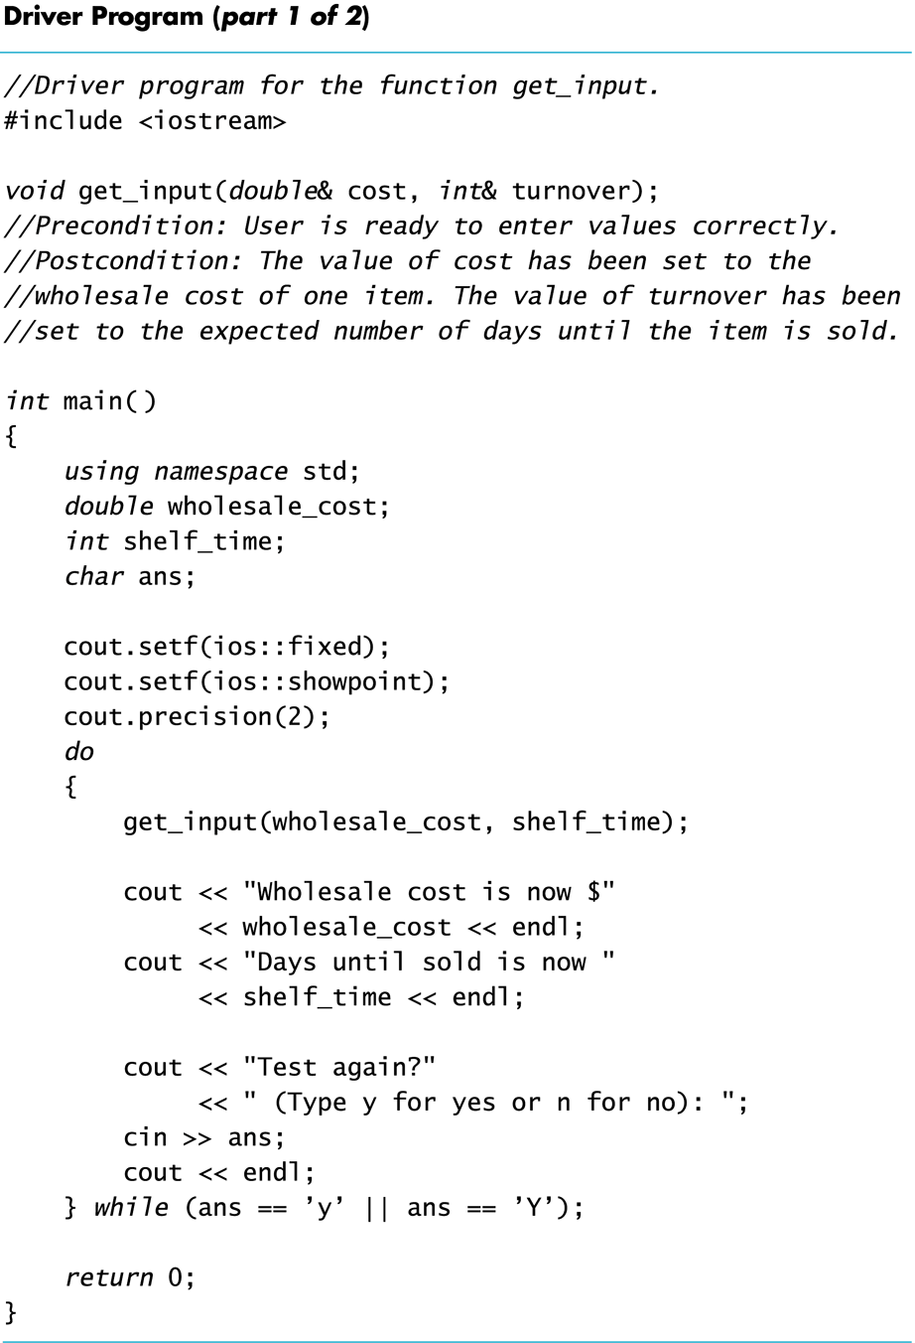
Display 5.10 (1/2)
Back
Next

Slide 69
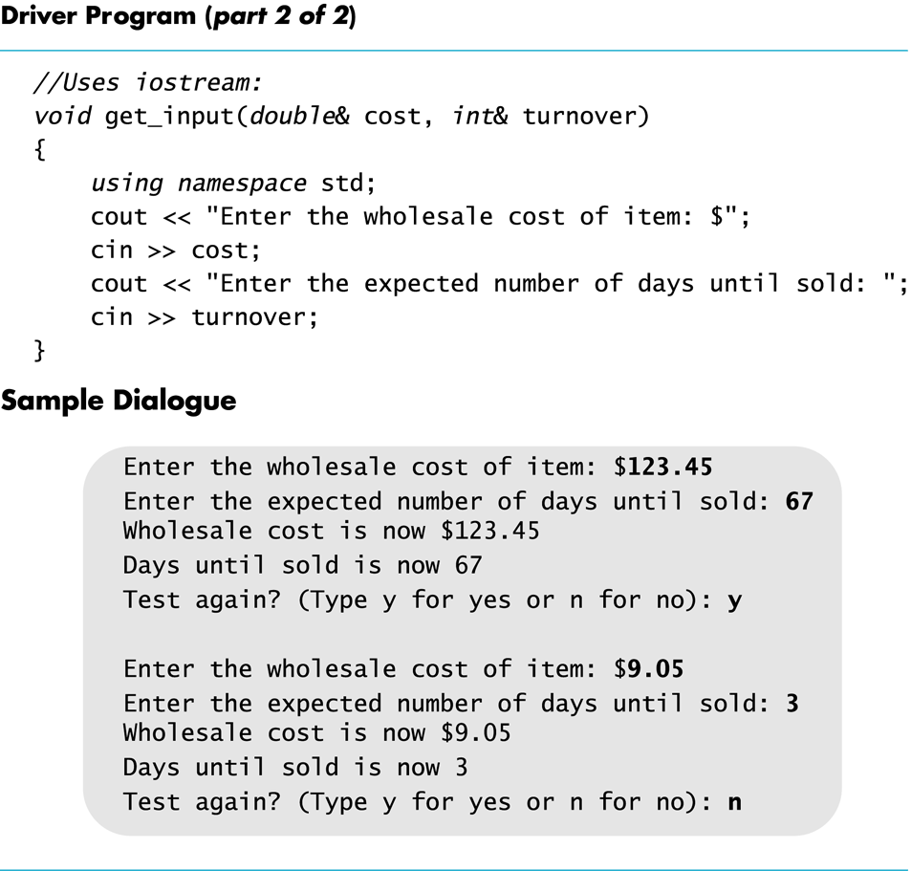
Display 5.10 (2/2)
Back
Next

Slide 70
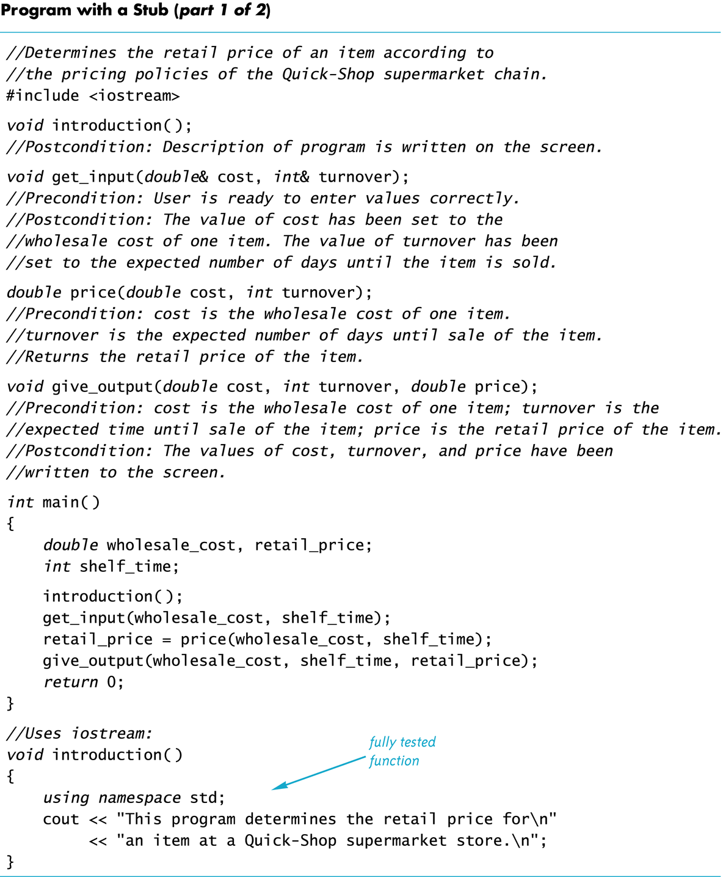
Display 5.11 (1/2)
Back
Next

Slide 71
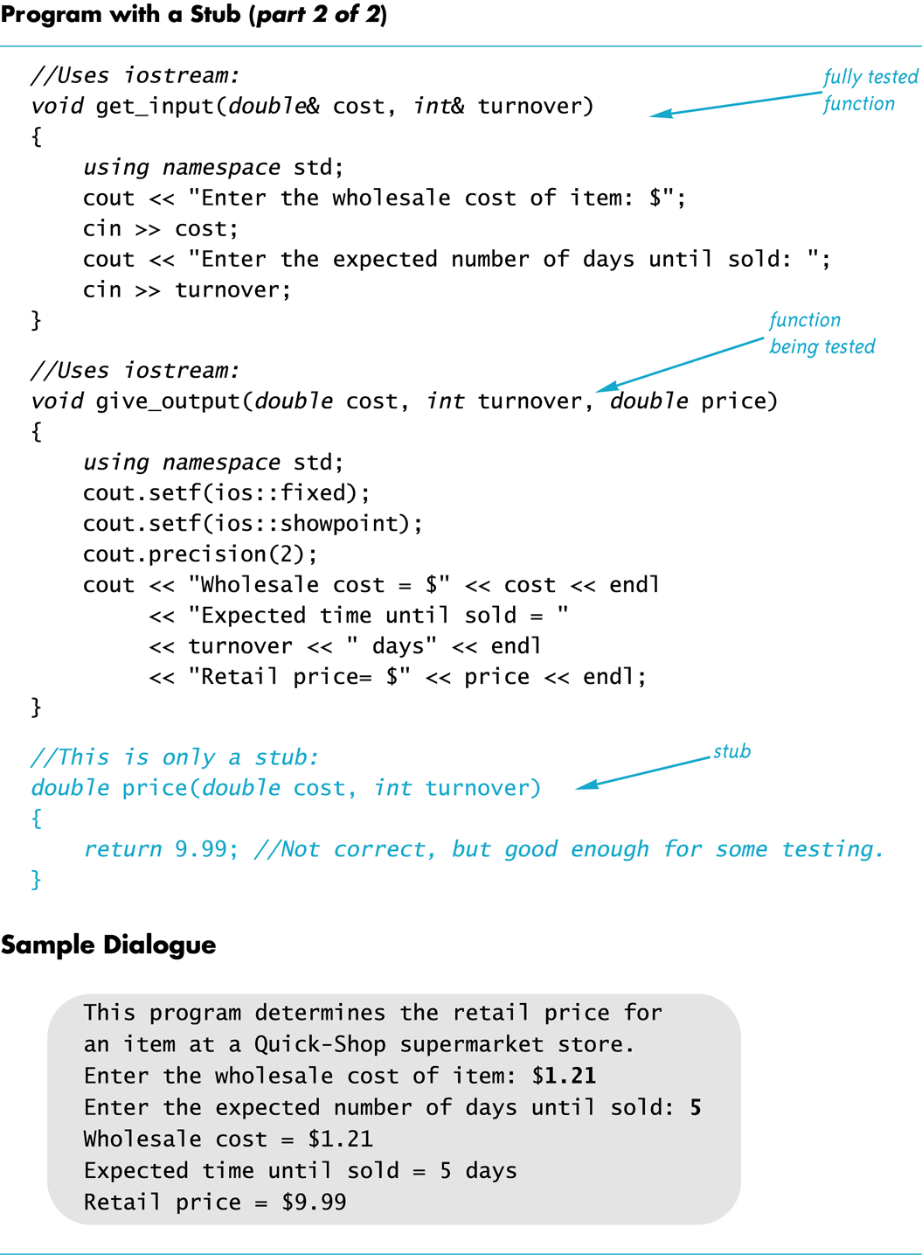
Display 5.11 (2/2)
Back
Next

Slide 72
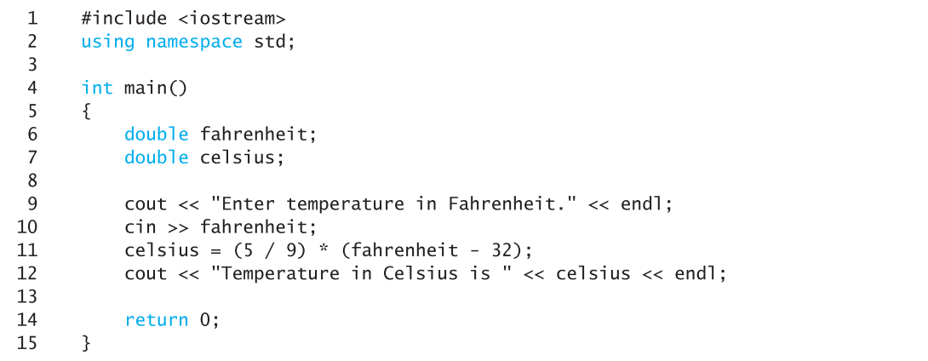
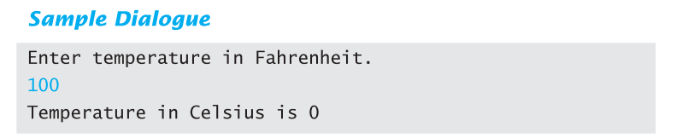
Display 5.12
Back
Next

Slide 73
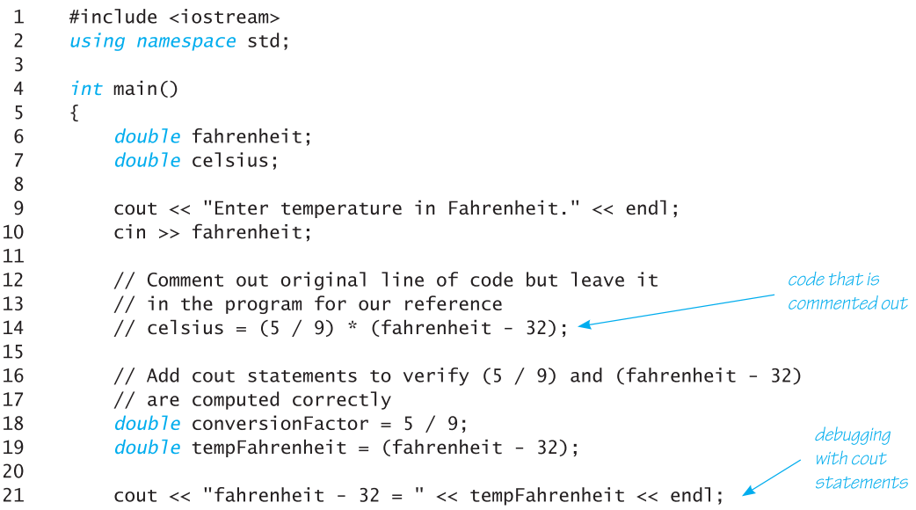
Display 5.13 (1 of 2)
Back
Next

Slide 74
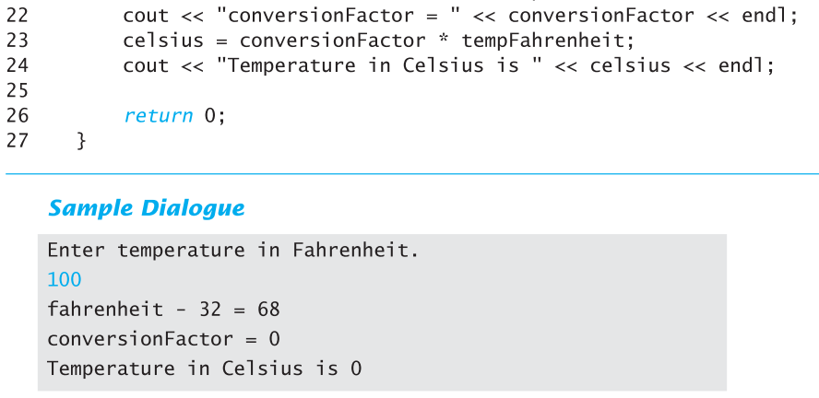
Display 5.13 (2 of 2)
Back
Next

